Slide 1
Retail Performance Analysis - Q3 2021
Allan Gachomo • 13.08.2025

Slide 2
Executive Summary
Analysis reveals four key challenges limiting performance:
Sell-out rates are below universal standards for both own brand and major vendors.
New customer acquisition is declining despite rising repeat sales.
Overstocked, underperforming store locations are tying up capital.
Best sellers are understocked while millions remain in unsold inventory.
Addressing these with targeted promotions, smarter inventory allocation, and data-driven replenishment could unlock significant revenue gains.

Slide 3
Objective
Maximize Sales Performance and Capital Efficiency in the Next Quarter

Slide 4
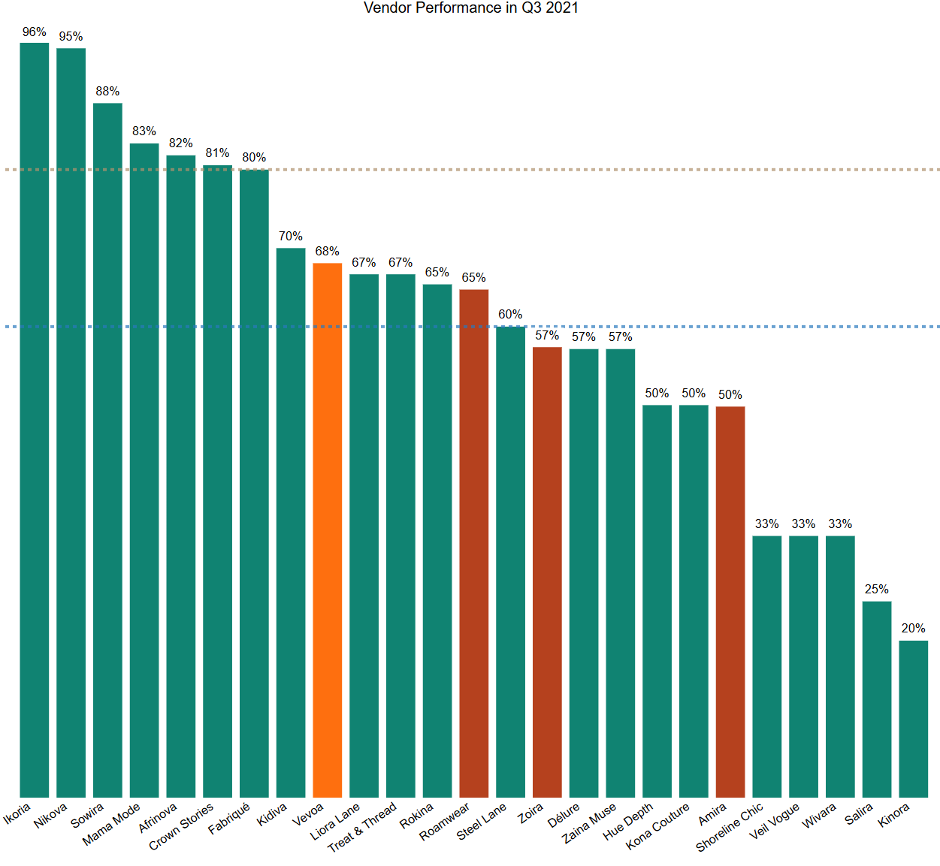
Vendor Underperformance Pulling Down Sell-Out Rates
80%
Company-wide sell-out rate: 66%
Universal benchmark of own brand: 80%
Major vendors: mostly below 60% universal benchmark
60%

Slide 5
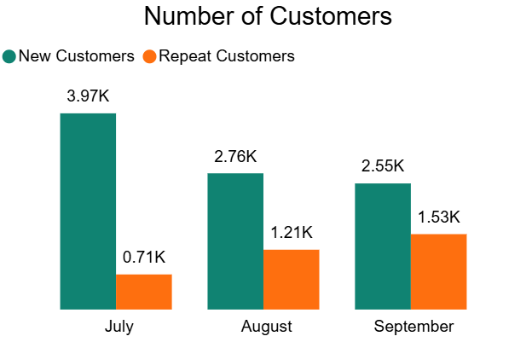
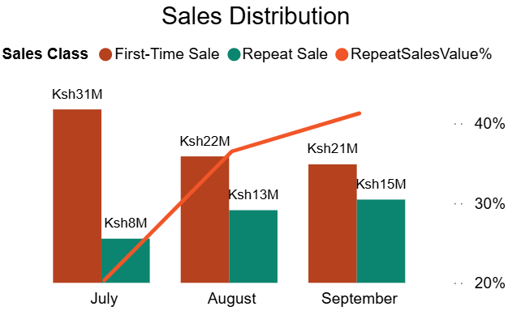
New Customer Acquisition Declining as Repeat Buyers Drive More Sales
New customers declining month-on-month
Repeat customers steadily increasing and contributing more sales
Sales share from new customers dropping over time

Slide 6
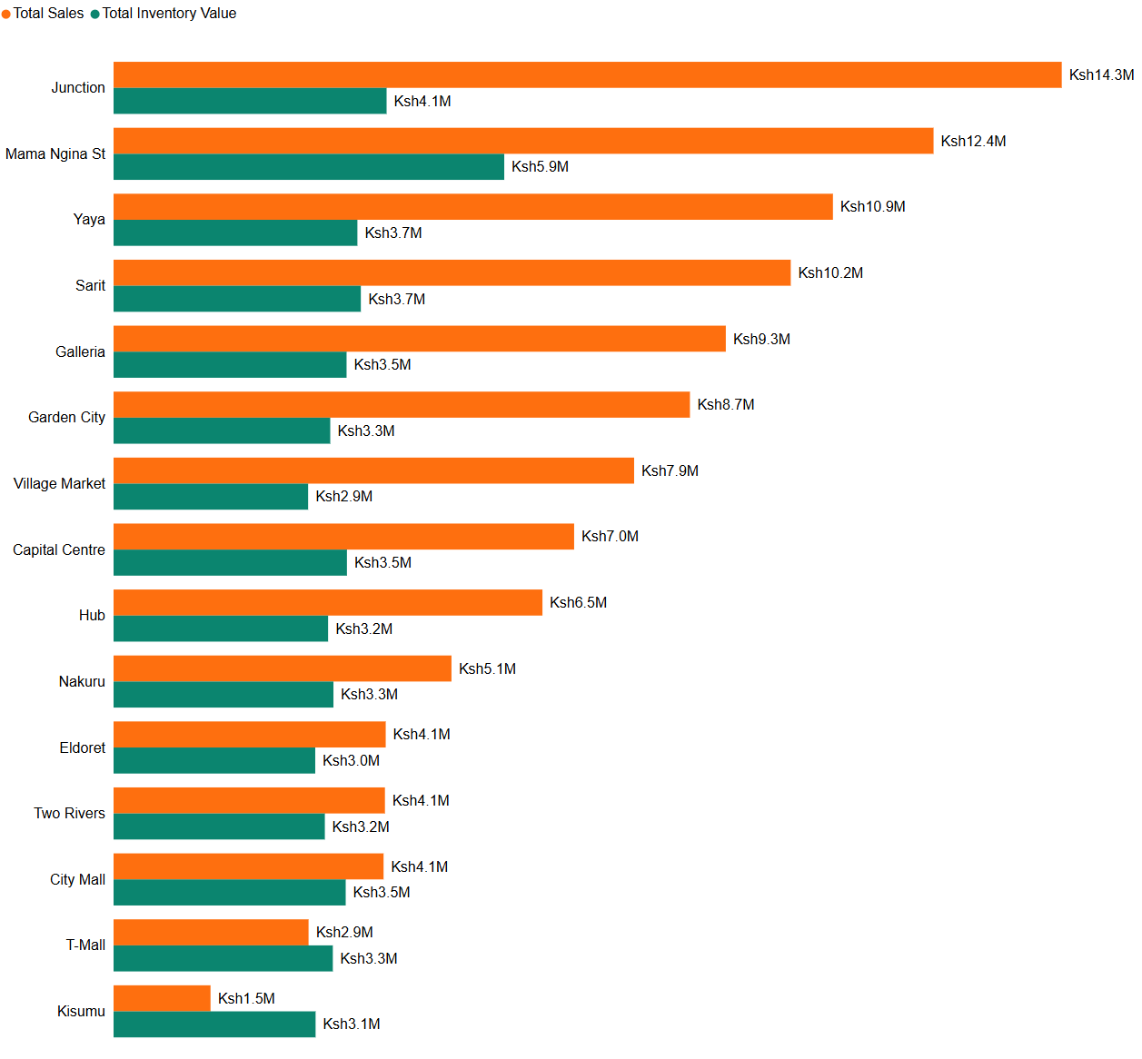
Underperforming Stores with Inventory Mismatch Draining Capital
Bottom 5 store locations generate 18.68% of revenue but hold 30.84% of inventory value
Top 5 locations: 52.41% of revenue, 39.24% of inventory value
Total Sales = 108.89M
Total Inventory Value = 53.39M

Slide 7
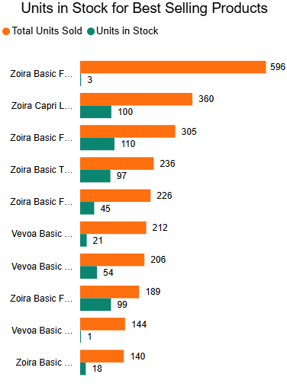
Best Sellers Out of Stock While Millions Sit in Unsold Inventory
Top-selling product (596 units sold) has only 3 units left across 15 store locations
Stock-to-sales universal benchmark = 1.5–2.0; most stores below 1.0 (see Appendix for full table)
Over KSh 4M tied up in products with zero sales in last 3 months (see Power BI Dashboard for full list)

Slide 8
Recommendations

Slide 9
Inventory rebalancing, loyalty program rollout, replenishment automation
09.05.XX
Short Term
Medium Term
Long Term
End-of-week promotions, clearance campaigns, first-purchase incentives
Advanced demand forecasting, product mix refinement, regional sales execution improvements

Slide 10
Appendix

Slide 11
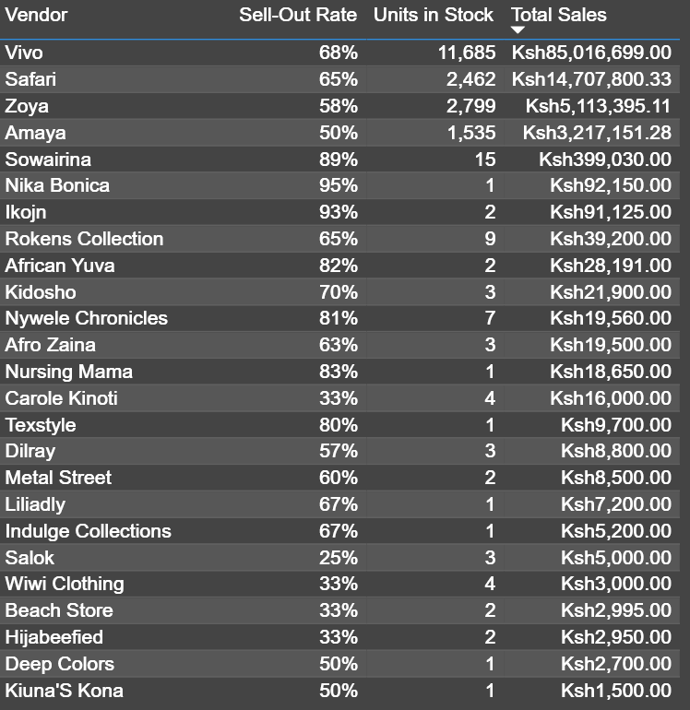
Reference for Slide 4
This table provides full details of the vendors and their sell-out rates
Total Sales and Units in Stock have been included to showcase the major players in our company

Slide 12
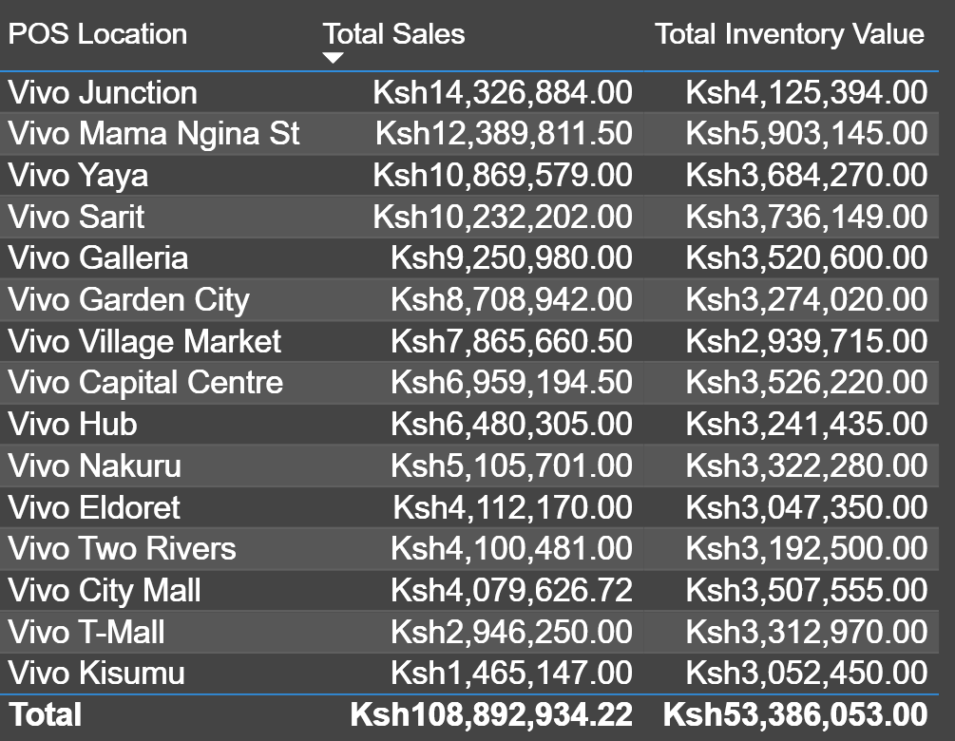
Reference for Slide 6
This table provides full details of the store locations along with their share of Total Sales as well as Total Inventory Value

Slide 13
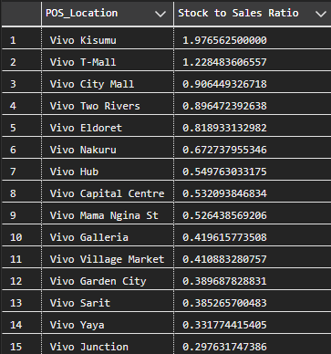
Reference for Slide 7
This table provides full details of the Stock to Sales Ratio for all the Store Locations
Kisumu can be seen as the only healthy location. This is still too early to tell because it has only been open for one month.

Slide 14
THANK YOU

